Slide 1
10 Oct group meeting

Slide 2
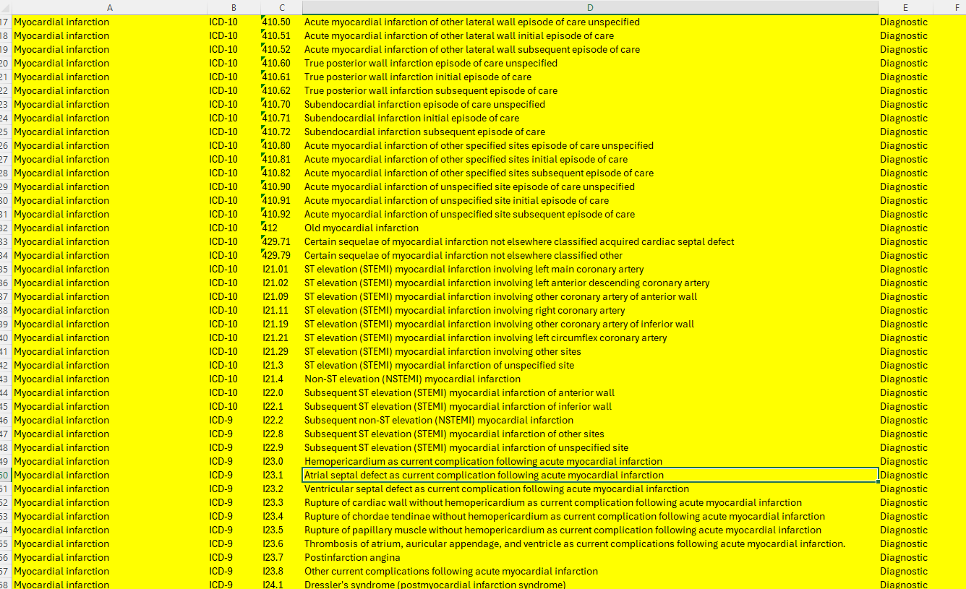
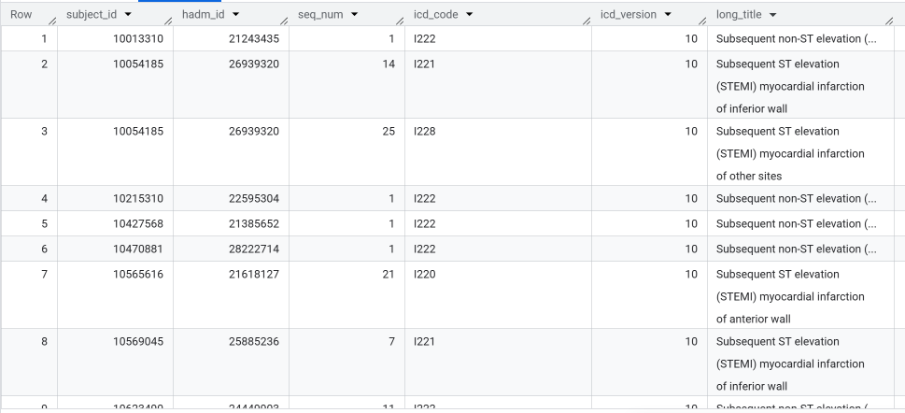




First thing we have to do: obtain icu stays for CHD patients. Then for each icu stay, we annotate it as to whether that patient is readmitted within 30 days.
- Why? since our goal is to predict which CHD patients are at a high risk of 30-day ICU readmission.
diagnosis_icd table
Hospital admission id
Optionally: filter based on seq_num <= k, say k=5?
So, what we have (for now) is:
Hospital admissions that are related to CHD.
HOWEVER: 1 Hospital admission -> 1 or more ICU stays. And we WANT ICU STAYS.

Slide 3
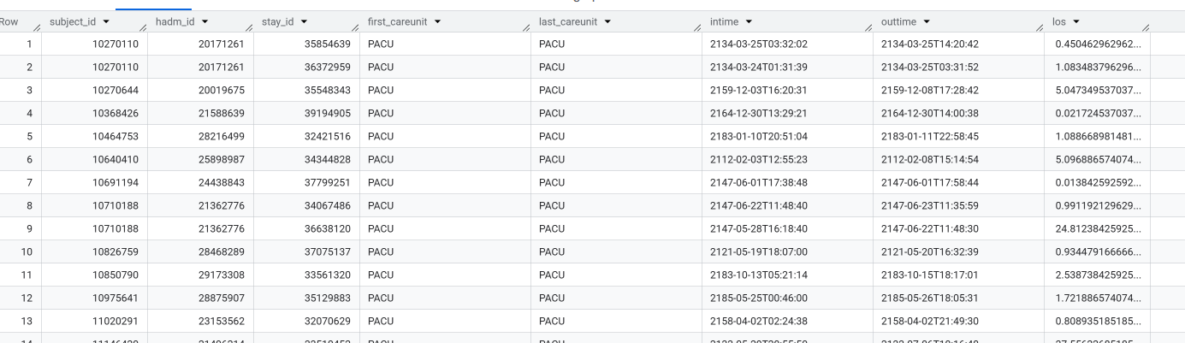


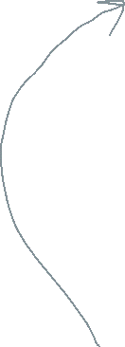

Recap: Filtered `diagnosis_icd` table with CHD-related admissions
🎯 Obtain CHD related ICU stays.
Filter`icustays` table (below) such that its (subject_id, hadm_id) falls into the above table
Output: All ICU stays with CHD related admissions.

Slide 4
This table: All ICU stays with CHD related admissions.
🎯 Label each ICU stay.
For each patient,
- Sort by `intime` (ICU admission time),
- So that we have ICU stays (for that patient) in chronological order.
For each ICU stay with (`intime`, `outtime`),
Look ahead at the next ICU stay of the same patient.
If the next ICU stay’s `intime` is within 30 days of the current ICU stay’s `outtime`,
label the current ICU stay as y=1 (otherwise y=0).
What we have now are labelled ICU stays:
(subject_id, hadm_id, stay_icd, intime, outtime, y (readmitted within 30 days?))
NOTE: Defining prediction time.
- One sample point = one ICU stay.
- If you have a patient just admitted to an ICU, with CHD, how likely will that patient be readmitted within 30 days?

Slide 5
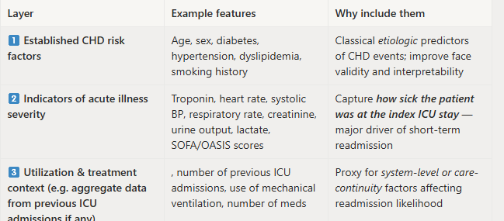
What we have now are labelled ICU stays:
Each row is (subject_id, hadm_id, stay_icd, intime, outtime, y (readmitted within 30 days?))
Obtain relevant features by joining (subject_id, hadm_id, stay_icd) to other relevant tables (e.g. chartevents, etc)
Optionally, we can refine the ICD-based CHD phenotype by lab measurements using the same key (subject_id, hadm_id, stay_icd) .
Just in case if our cohort is very large in size.
But the most important one is 1 for now. But which features do we want to consider?
Known CHD risk factors (do research to find out what are they)
- Rationale: Improve interpretability and validity of our ML models
Illness severity indices (e.g. Charlson comorbidity, apsiii, SOFA, etc)
- Rationale: how sick the patient was during the ICU stay
Any data related to prior ICU admissions for that patient (e.g. number of previous ICU admissions, etc)
- Rationale: these may affect readmission likelihood.

Slide 6
19 Oct group meeting

Slide 7
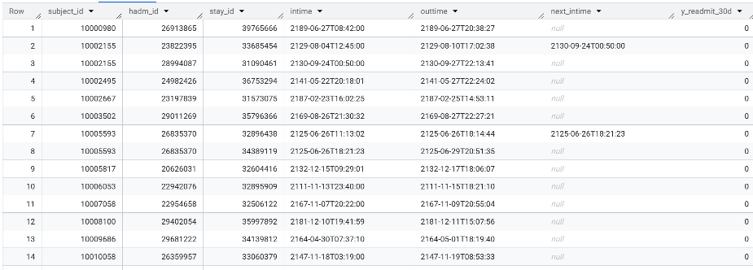

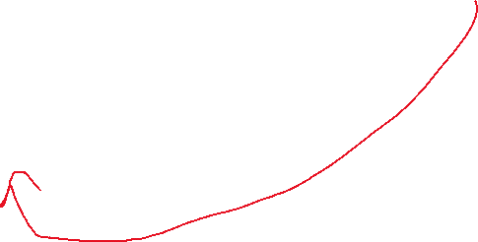






(1) diagnosis_icd table: retrieve relevant admissions
(2) Icu_stays table: retrieve relevant icu stays
With k=5, prop = 0.091, n=6821, 623 readmissions

Slide 8


Further filtering: K=10 (be more liberal with ICD based phenotyping, let the lab measurement do the filtering)
Compared to ICD-based only
- k=5, prop = 0.091, n=6821, 623 readmissions

